Slide 1
BITCOIN TRANSACTION: FROM THE CREATION TO VALIDATION, A PROTOCOL OVERVIEW
Under the Guidance of
Mr. SUHAS K C Assistant Professor,
Dept. of CSE,
CIT, Gubbi
Tumakuru
Presented by
SUHAS V
1CG16CS100
VIII Sem ‘B’ Sec
CIT, Gubbi
Tumakuru

Slide 2
CONTENTS:
INTRODUCTION
OBJECTIVE
OVERVIEW
SYSTEM DESIGN
DATA STRUCTURES
VALIDATION METHODS
CONCLUSION

Slide 3

INTRODUCTION:
Bitcoin was introduced by Satoshi Nakomoto in November 2008.
Bitcoin is a decentralized cryptographic currency and first to implement block chain.
Bitcoin is referring to token/currency associated with technology.

Slide 4
OBJECTIVE:
The challenges that expected to resolve:-
Autonomous decision making:
Standardization:
Safe, reliable and effective communication:

Slide 5
Overview:
A bitcoin is divided in satoshi, 1 BTC = 100,000,000 satoshi.
Bitcoin is first of all a network of nodes, each one storing the blockchain.
Everyone can verify the content of the blockchain and this content is replicated on each node of the network.

Slide 6
System dEsign:
It consists of four parts:-
Transaction:
Blocks:
Block chain:
Block chain forks:

Slide 7
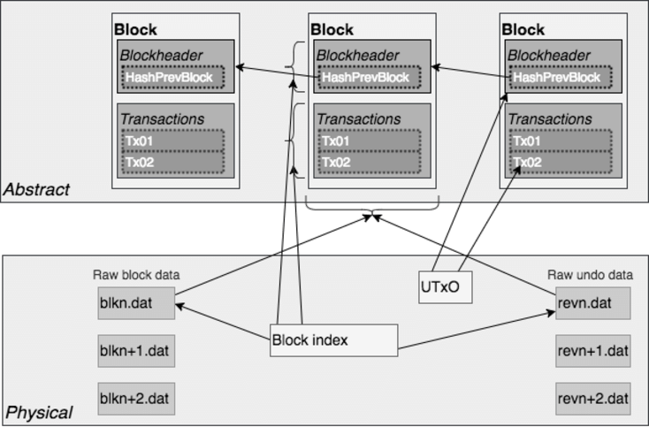
Data structureS:
Fig. Architecture and interaction between the data of Bitcoin Core

Slide 8
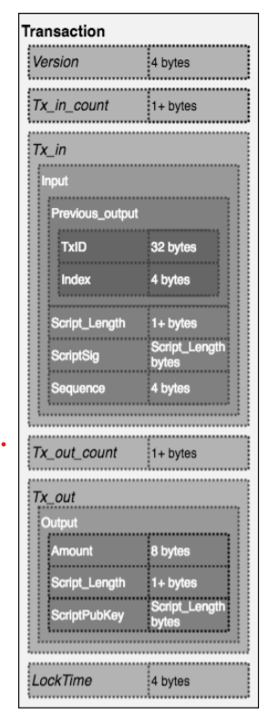
A. Transaction Data Structure:
Fig. Transaction data structure, in this example there is only one input and one output

Slide 9
SCRIPT:
The common use of the script for standard transaction is the Pay To Public Key Hash (P2PKH) and a more sophisticated script is the Pay To Script Hash (P2SH). Both of those scripts validate the proof of ownership when they are executed along a ScriptSig.
ScriptSig-
P2PKH-
P2SH-

Slide 10
B. Block data structure:
Fig. Block data structure

Slide 11
C. Databases:
Bitcoin core software uses four databases:-
Raw block data
Block index
Unspent transaction output
Raw undo data

Slide 12
Validation methodS:
After the Transaction creation it should be validated.
Transaction creation
Transaction validation
a. Version verification
b. Simple verification
c. Signature verification
d. Locktime verification

Slide 13
CONCLUSION:
The expensive element of the validation is the verification of script which needs more computational power.
The protocol ensures that valid blocks are added to blockchain.

Slide 14
THANK YOU

